Slide 1
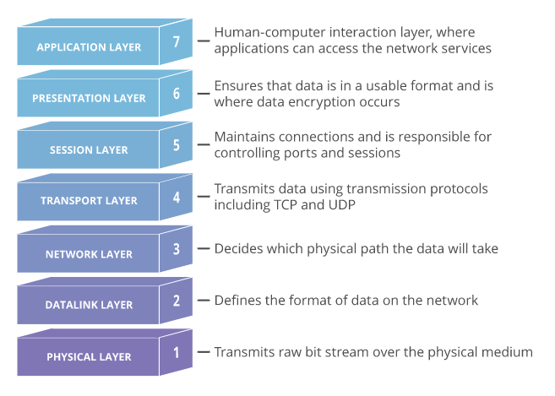
OSI Model

Slide 2
ISO OSI Model
The open systems interconnection (OSI) model is a conceptual model created by the International Organization for Standardization (ISO)
It enables diverse communication systems to communicate using standard protocols
OSI provides a standard for different computer systems to be able to communicate with each other.
The OSI Model can be seen as a universal language for computer networking.
It’s based on the concept of splitting up a communication system into seven abstract layers, each one stacked upon the last.

Slide 3
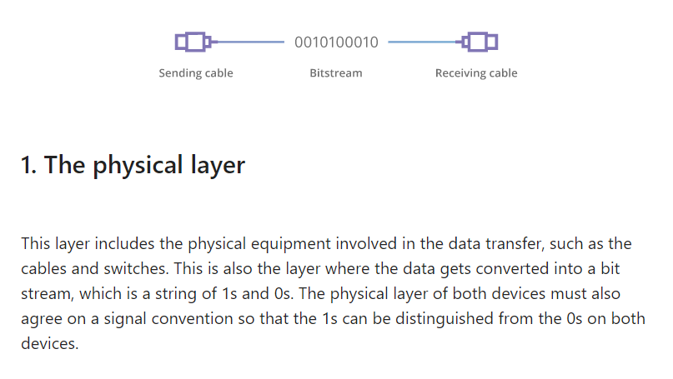

Slide 4
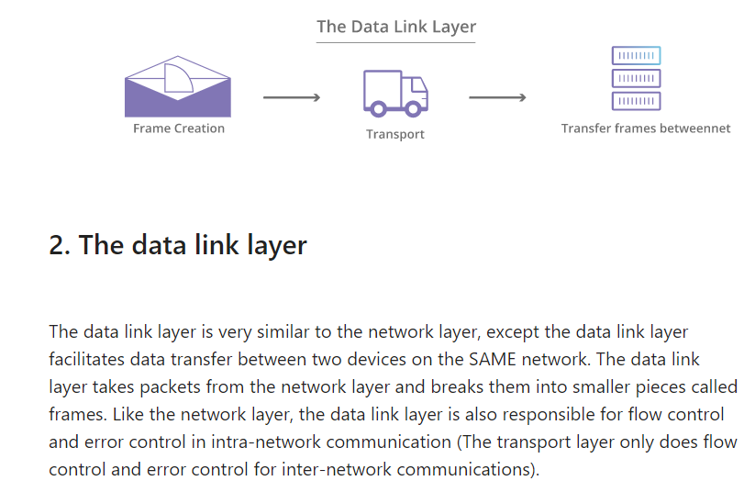

Slide 5
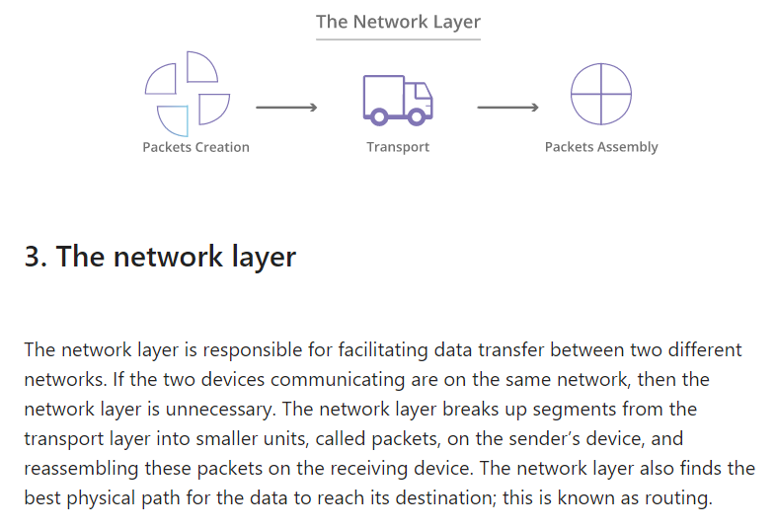

Slide 6
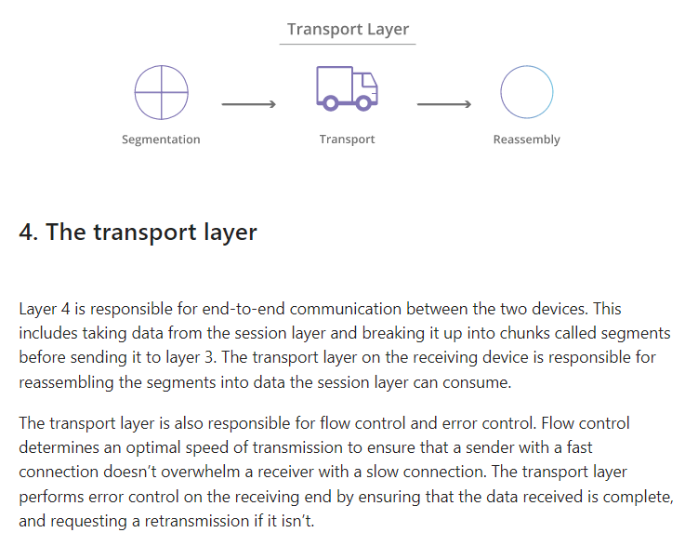

Slide 7
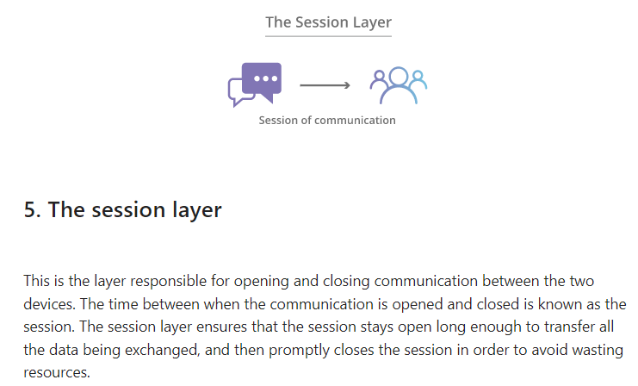

Slide 8
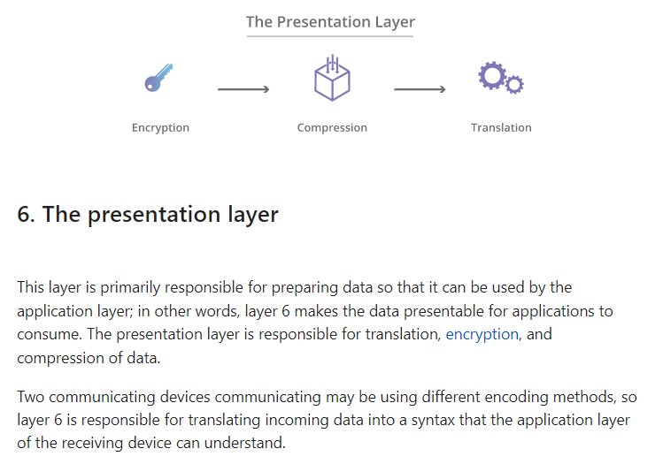

Slide 9
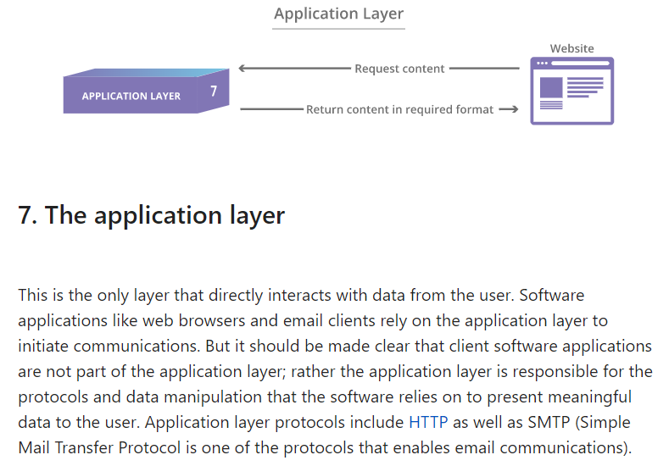

Slide 10
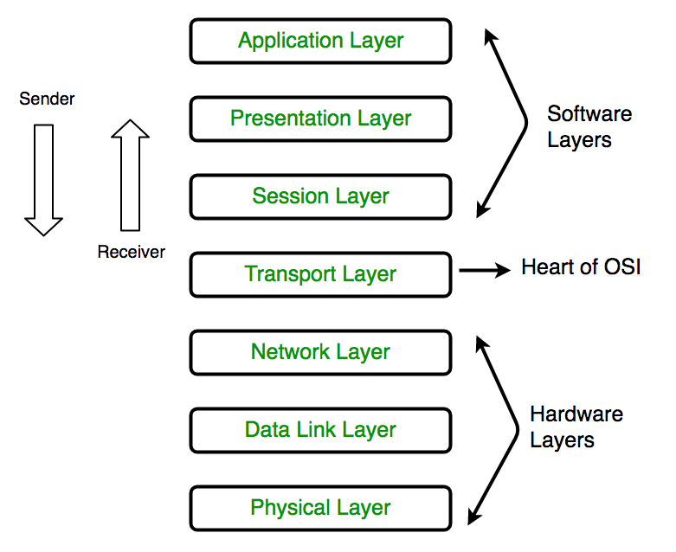

Slide 11
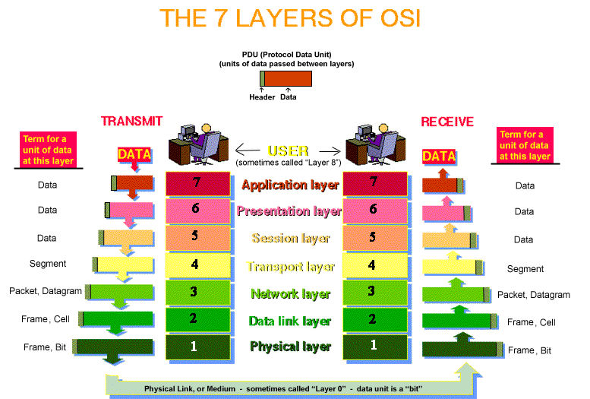

Slide 12
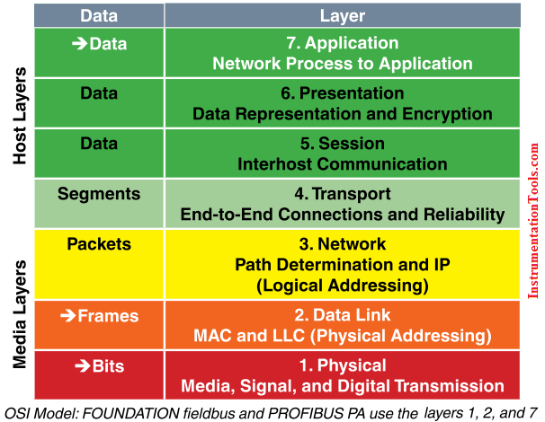

Slide 13
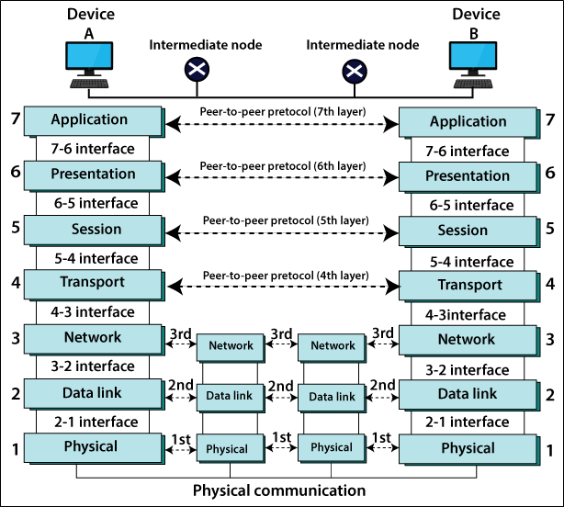

Slide 14
